Slide 1

Trade!t Modelling and Simulating Social Systems
Alessandro Menichelli, Vincent Wüst, Firehiwot Kedir

Slide 2
Content
Introduction
Model
Implementation
Results
Conclusion
Q&A

Slide 3

Introduction-Financial market
A platform for buyers and sellers
Electronic trading
Provides liguidity to tradable assets
Artifical Financial Market
Predict/determine prices of assets
Market collapse
Image credit:SergeyP/Shutterstock
Notes:
Buyers and sellers could be either individuals or companies

Slide 4
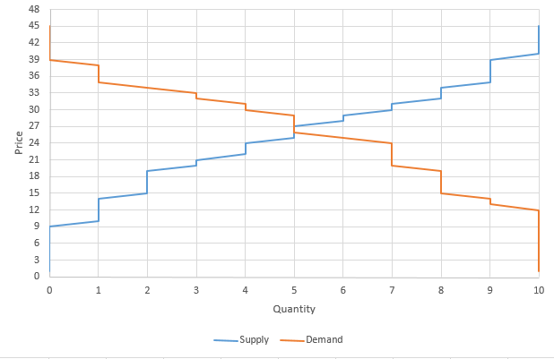
Introduction-Previous works
(Raberto et al. 2001
Multi agent market model
Budget constraint
Price formation:
Intersection of the supply and demand curve
(Raberto & Cincotti, 2005)
Multi agent market model
Budget constraint
Price formation
Limit Order Book(LOB)
Limit order Book
Agent ID | Sell Price | Agent ID | Buy price
... | ... | ... | ...
Source: https://education.howthemarketworks.com/economics/supply-and-demand-examples-stock-market/
Notes:
LOB: A limit order book is a record of unexecuted limit orders maintained by the security specialist who works at the exchange

Slide 5
Introduction-Current research
Research Motivation
To mimic a real Fiancial Market
To identify impediements in doing so
Research Questions
What is the reproducibility potential of the research(Raberto & Cincotti, 2005)?
What are the similarities and differences in the outputs of the simulations?
Is an improvement possible?

Slide 6
Model-Approach
Concept taken from (Raberto and Cincotti, 2005)
Agent based Simulation
Fundament
Agents represent traders
One asset tradet
No money creation
LOB as price formation mechanism
Simple Model and Advanced Model

Slide 7
Process Diagram
Simple Model

Slide 8
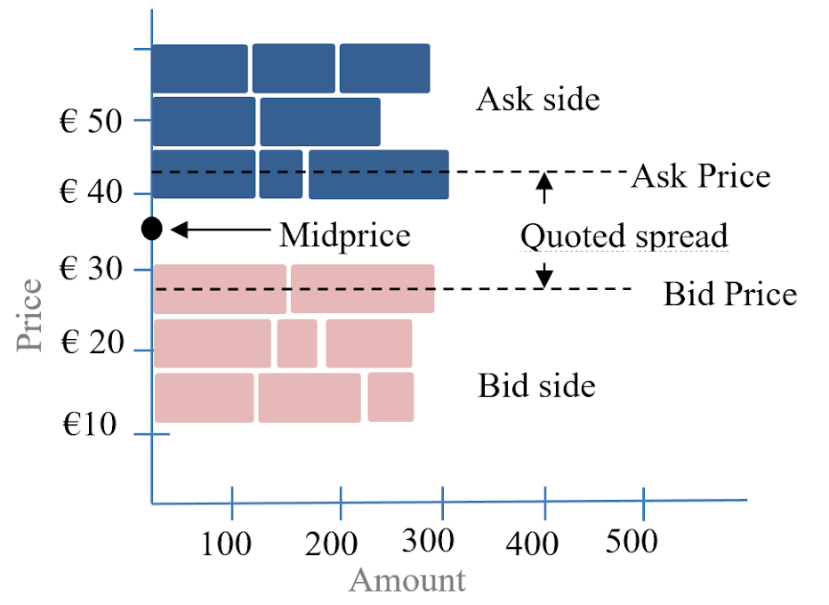
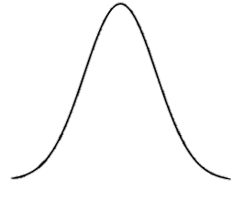
Process Diagram
Simple Model

Slide 9
Trade amount:
Random fraction of what both seller and buyer can provide at price per share they agreed up on.
Process Diagram
Simple Model

Slide 10
Process Diagram
Advanced Model

Slide 11
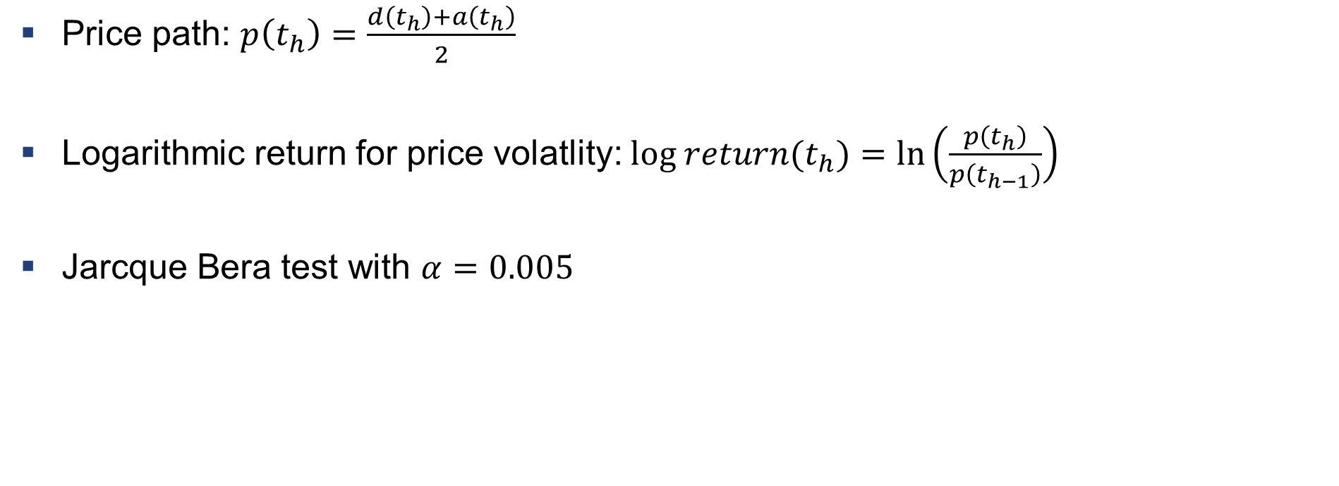
Implementation - Analysis Tools
Price path: $p\left(t_{h}\right)=\frac{d\left(t_{h}\right)+a\left(t_{h}\right)}{2}$
Logarithmic return for price volatlity: $log return(t_{h})=\ln\left(\frac{p\left(t_{h}\right)}{p\left(t_{h−1}\right)}\right)$
Jarcque Bera test with $α=0.005$

Slide 12
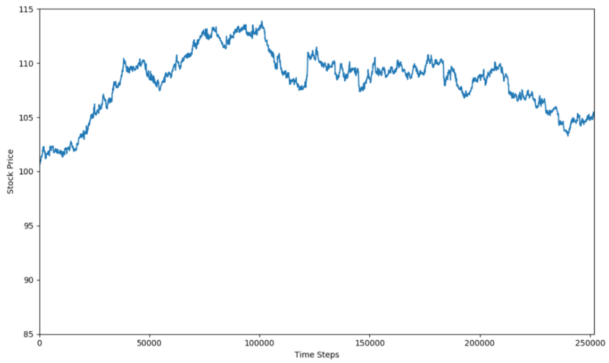
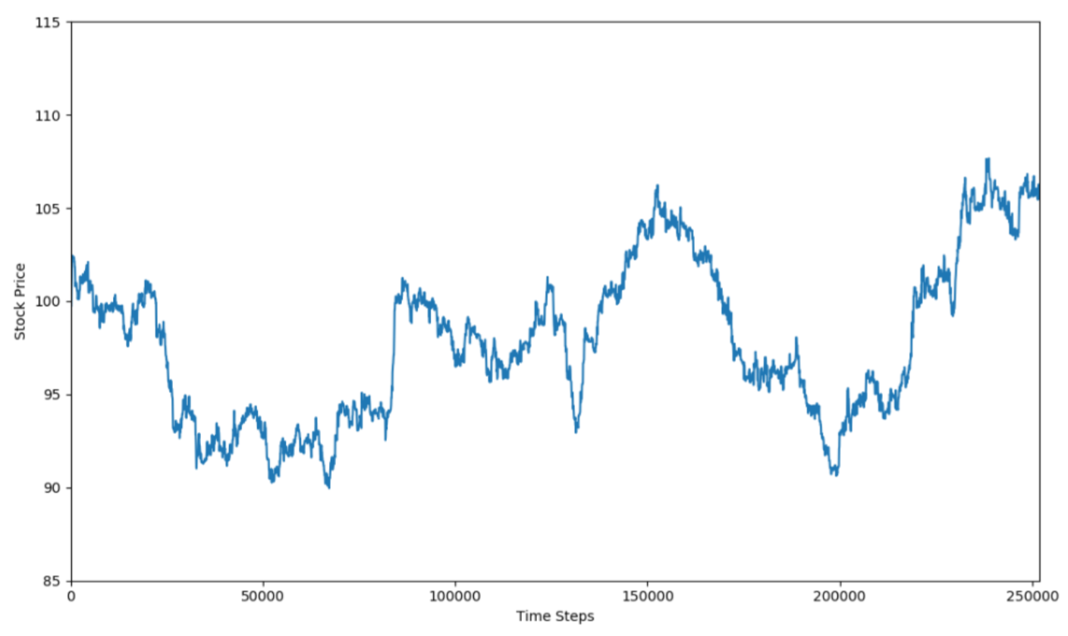
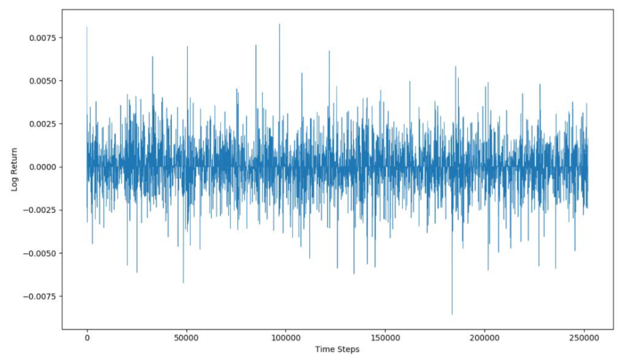
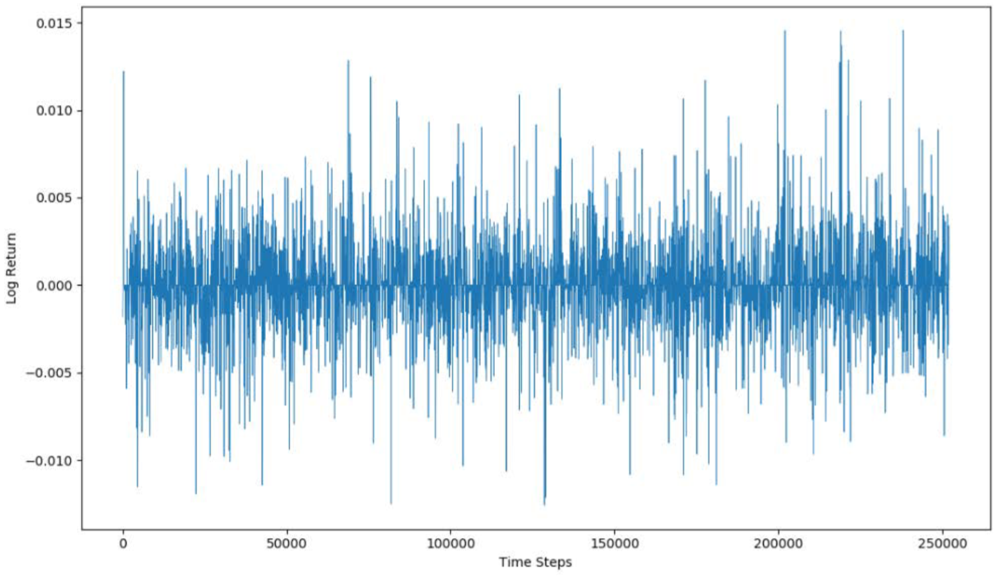
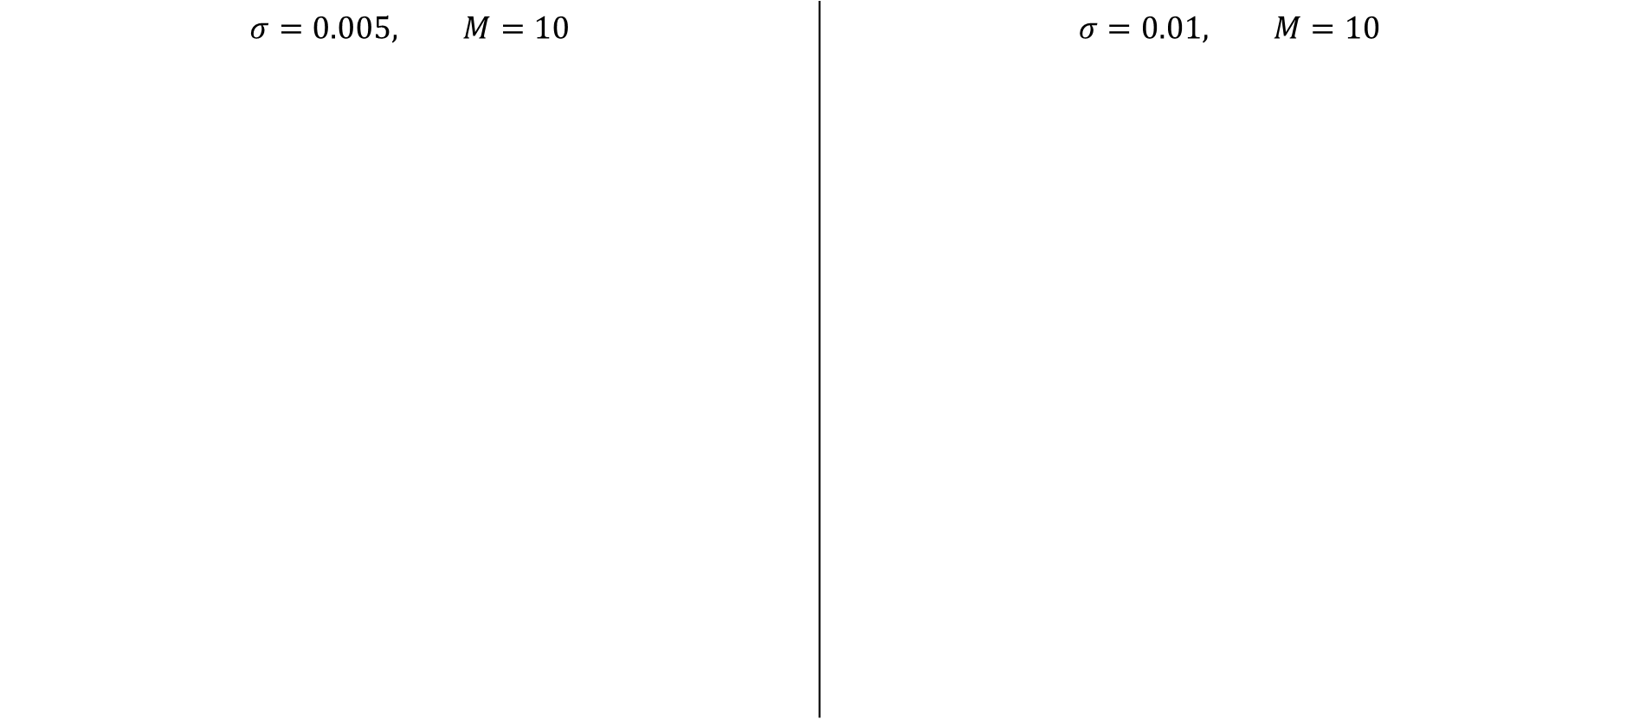
Results - Simple Simulation
$$σ=0.005, M=10$$ | $$σ=0.01, M=10$$

Slide 13
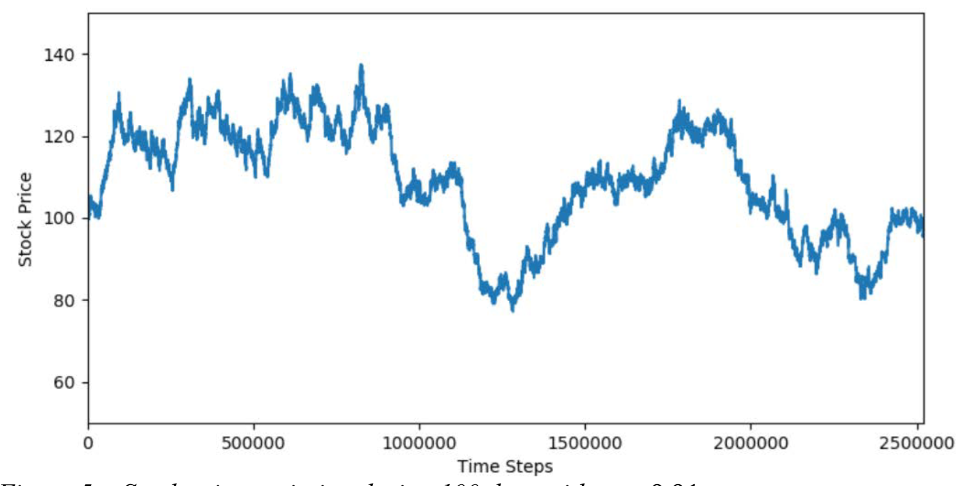
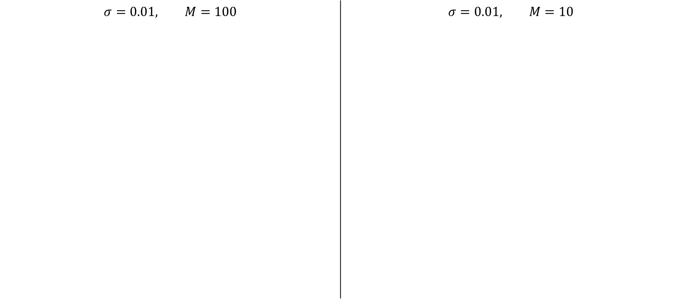
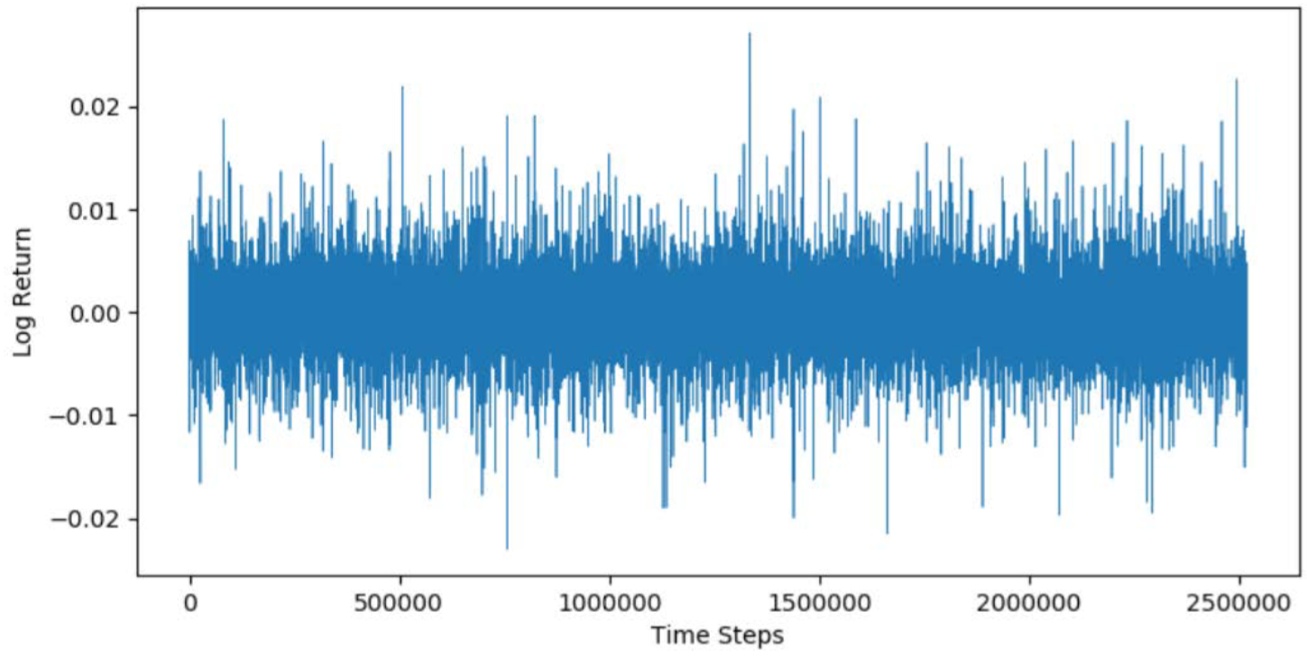
Results - Simple Simulation
$$σ=0.01, M=100$$ | $$σ=0.01, M=10$$

Slide 14
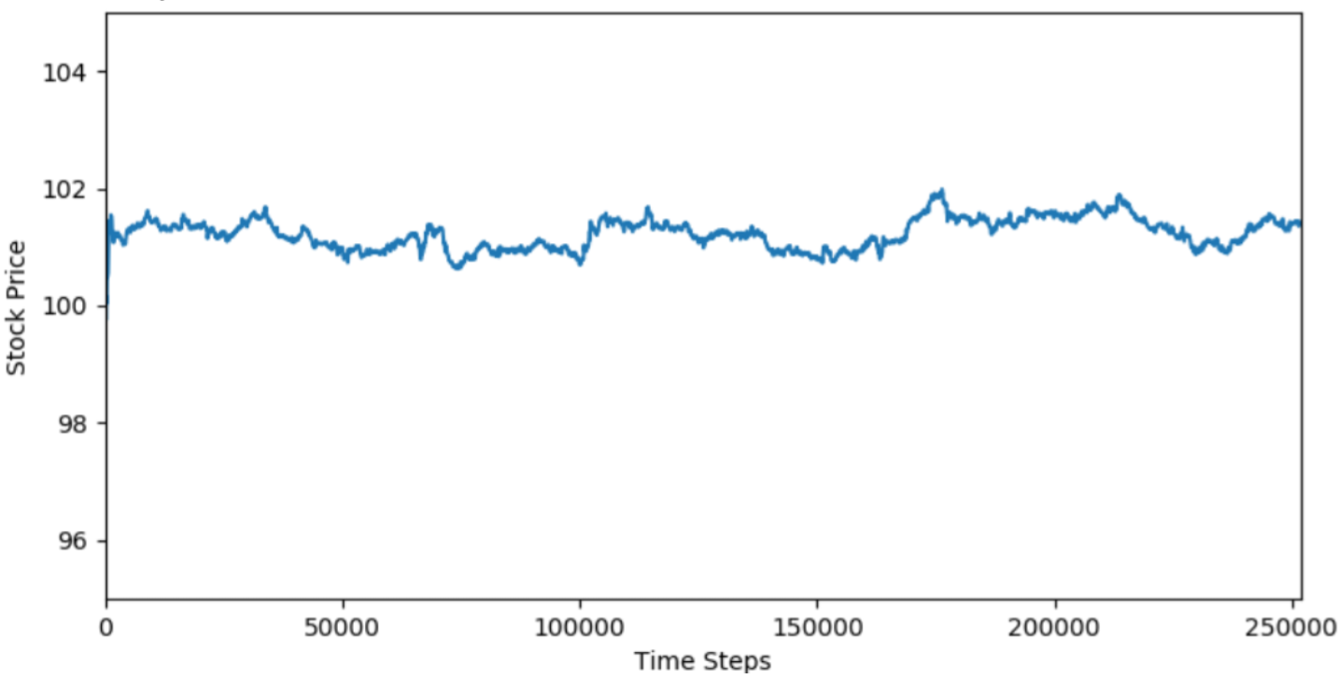
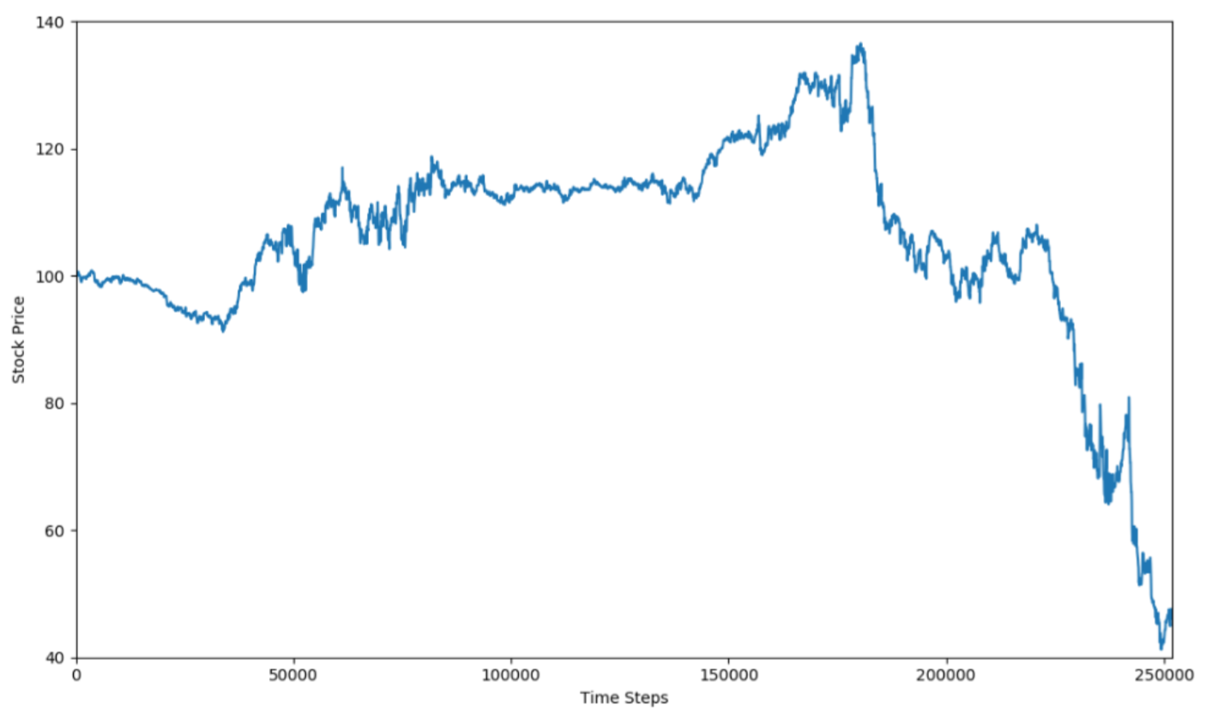
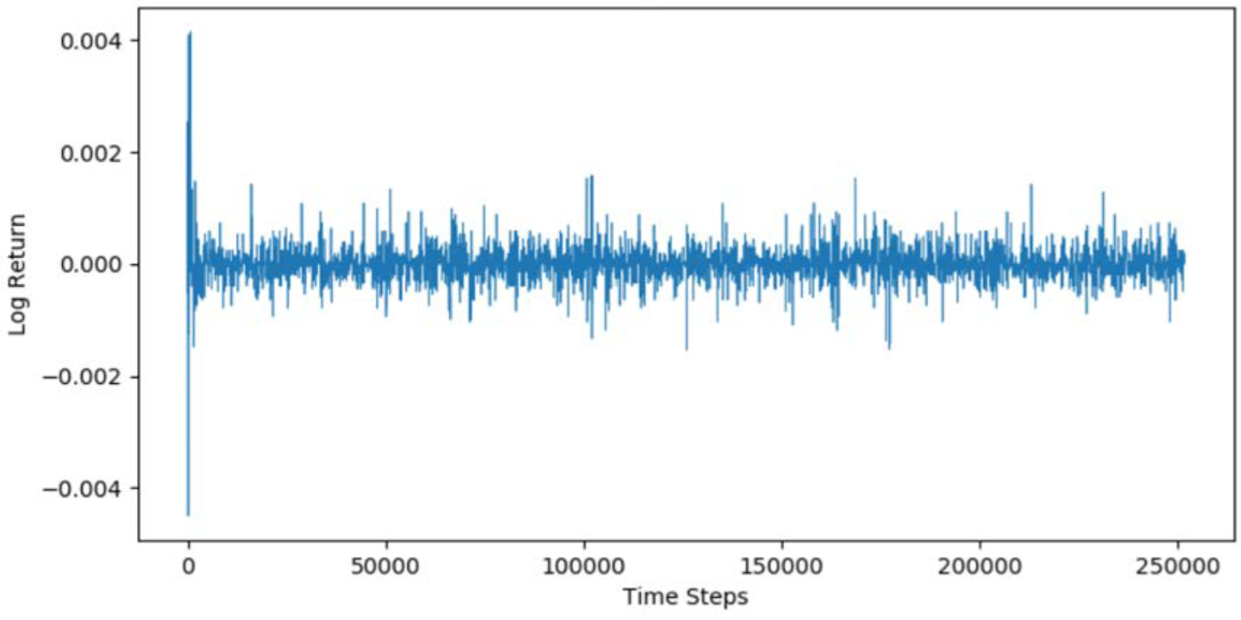
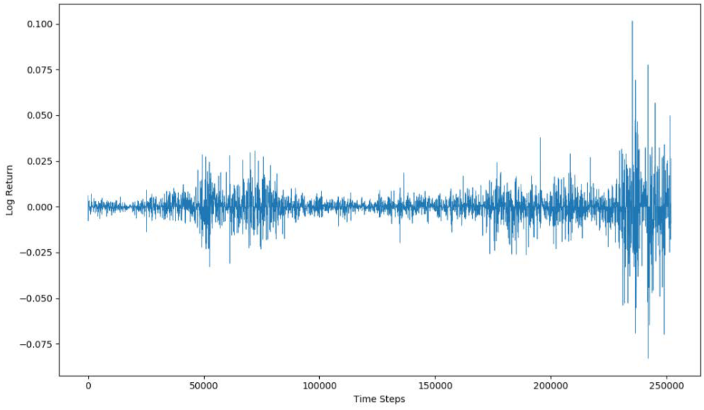
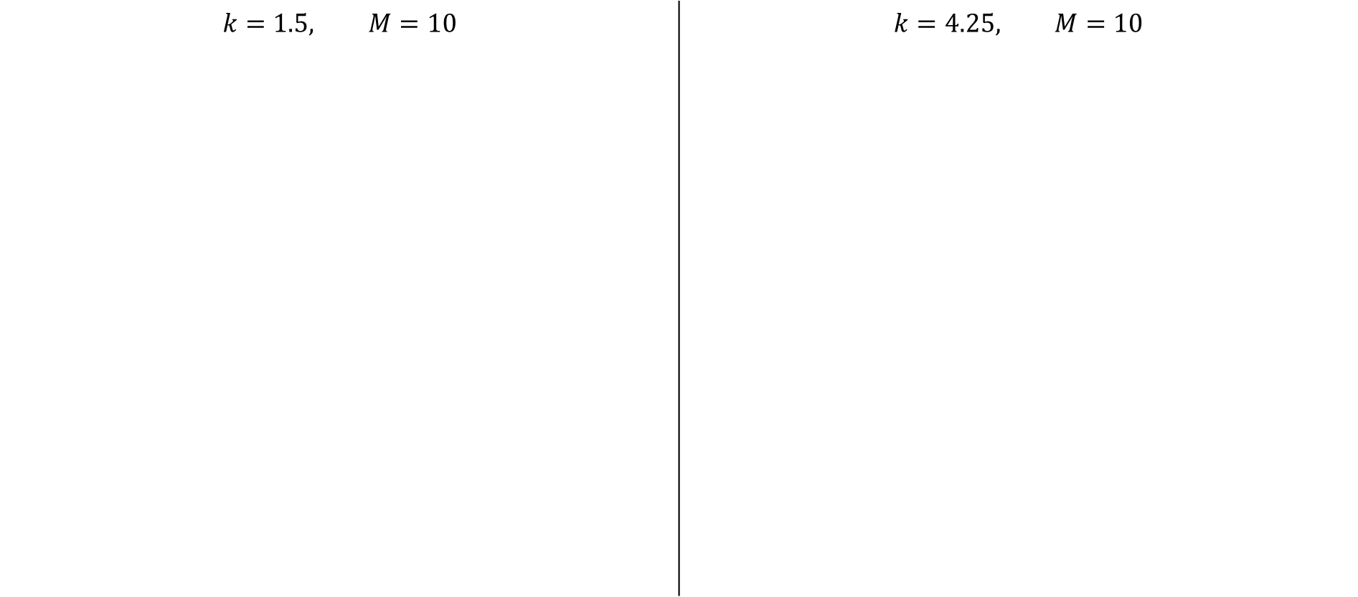
Results - Advanced Simulation
$$k=1.5, M=10$$ | $$k=4.25, M=10$$

Slide 15
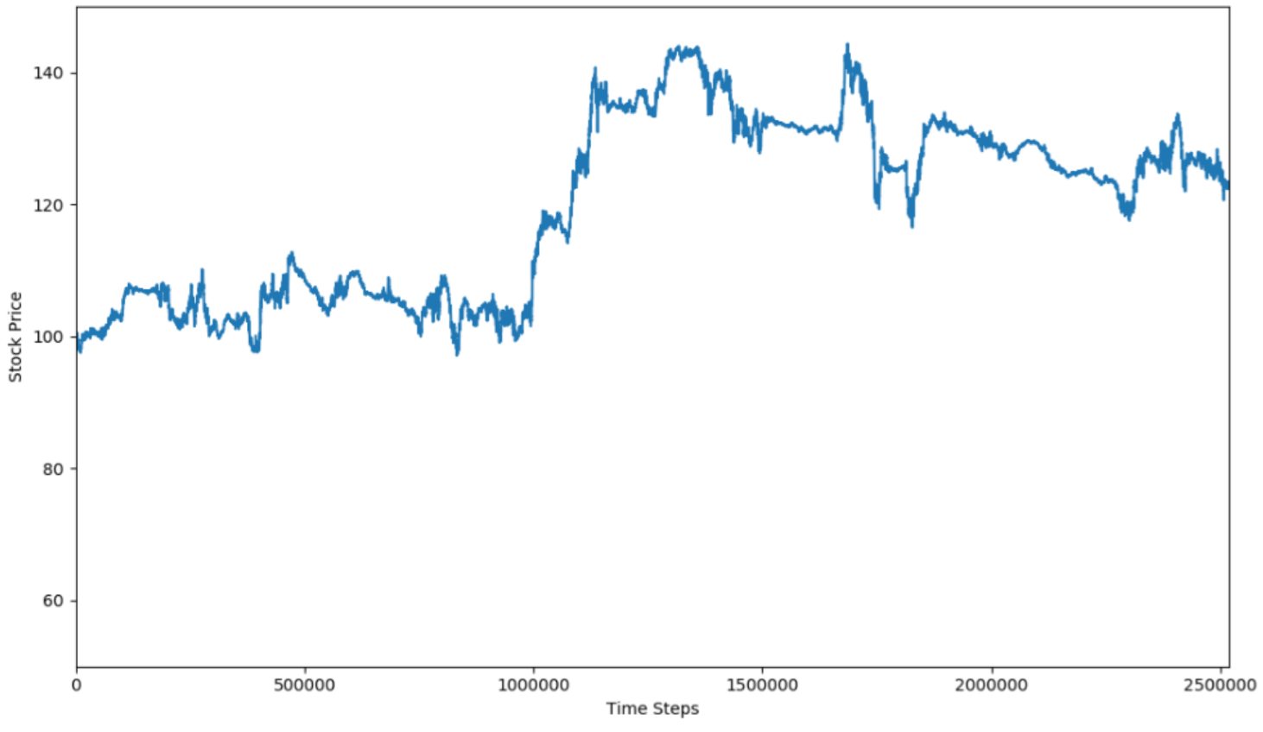
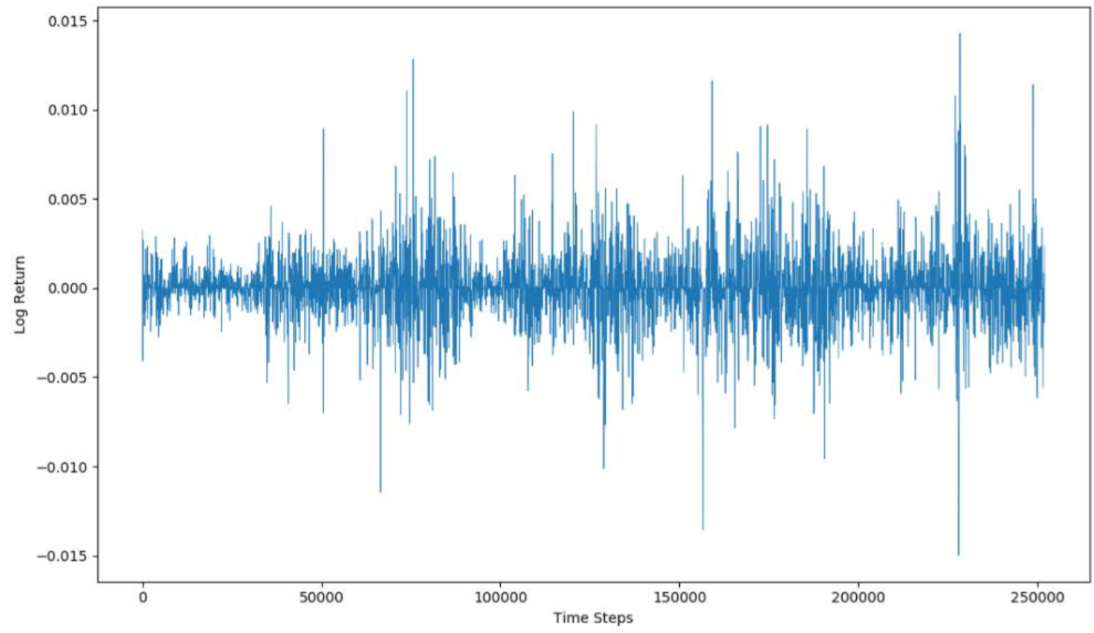
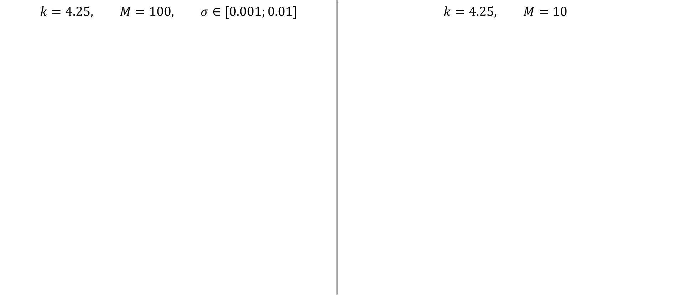
Results - Advanced Simulation
$$k=4.25, M=100, σ∈[0.001;0.01]$$ | $$k=4.25, M=10$$

Slide 16
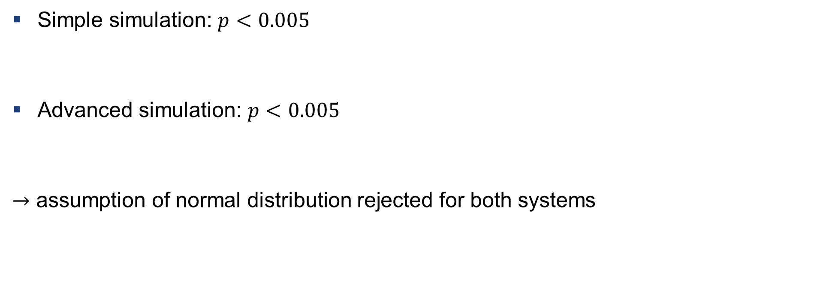
Results – Jarcque Bera test
Simple simulation: $p<0.005$
Advanced simulation: $p<0.005$
$→$ assumption of normal distribution rejected for both systems

Slide 17
Conclusion
Critical view of the project
No money creation
Only one asset
Possible improvements
Better stock price estimation
Better code so that bid price cant reach zero value
Plotting changement of agent wealth

Slide 18
Question and Answer
Thank you

